Slide 1
Capstone Project
Operating Systems Funadamentals

Slide 2
Table of Content
Introduction
Users
File Structure
Group Accounts
Permissions
Backup
Conclusion

Slide 3
Introduction- 1
Akamai has ordered a File Server. The company is called SpeedVane, and we are tasked to create 2 permanent users and 2 6-month interns. Set up the files properly,and give the proper permission to each user and finally set up a backup.

Slide 4
Users- 2
We are tasked to create 2 permanent employees, and a 6-month contract to 2 new interns.

Slide 5
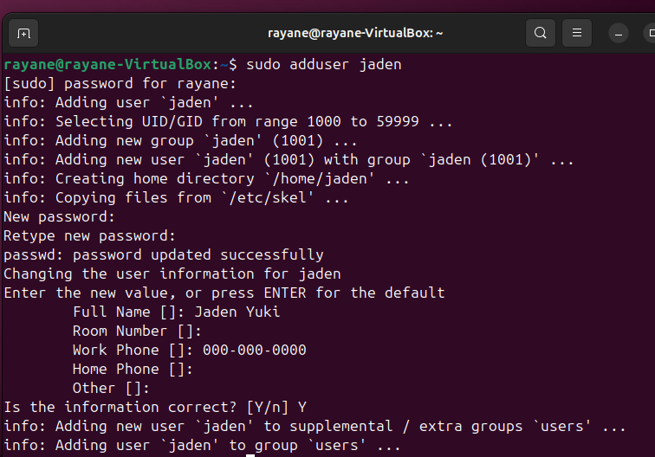
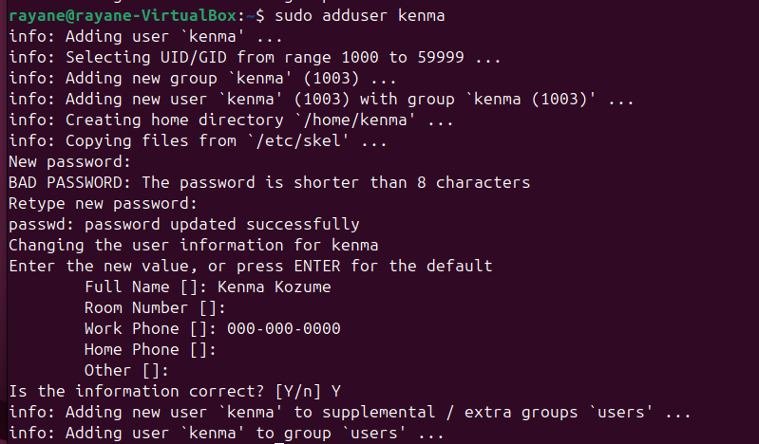
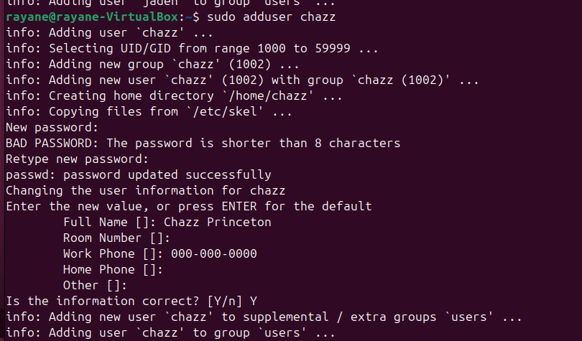

User Accounts
To create a user, we use the command:
  adduser
Permanent employees:
  Username: jaden
    Password: clayman!@#
  Username: chazz
    Password: duel123
6-month contracted employees:
  Username: kenma
    Password: kozuken
  Username: lev
    Password: haikyUu

Slide 6
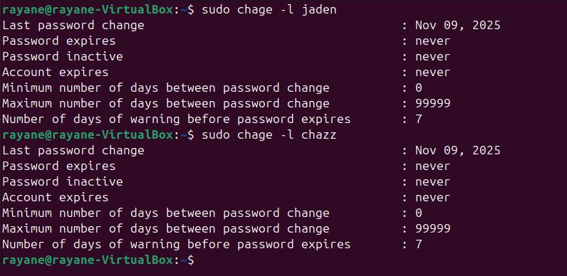
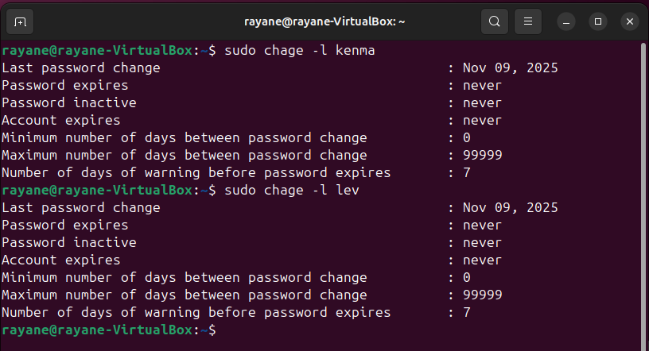
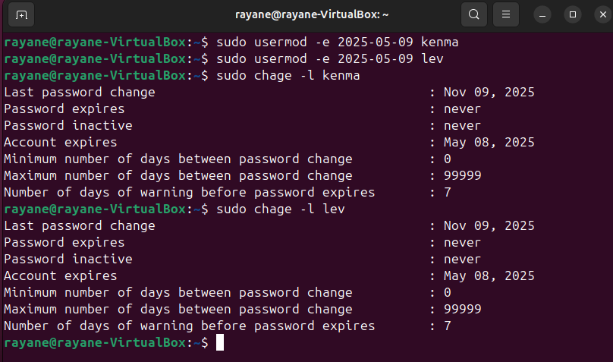
User Accounts
To check expiration date to our 2 interns we use command:
  chage
We keep our permanent employees as never for expiration whereas for the 2 interns they will only stay for 6 months.
To set it we use the command:
  usermod
  Today is 9/11/2025 so 6 month from now would be 9/5/2026

Slide 7
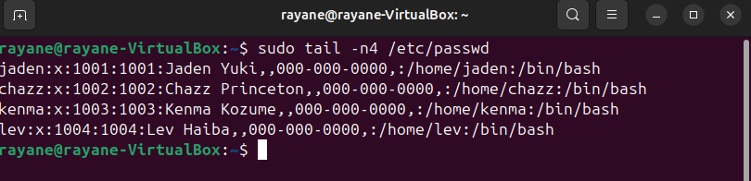
User Accounst
To check if all our accounts were successfully created:
  Just use sudo tail –n4 as they would be the most recent thing we did to

Slide 8
File Structure- 3
Here we will create 2 folders, one for our permanent employees, and one for the interns with their respective files. Each Folder will have 2 folders of their own: UX and IT. _Permanent for the permanent users _Inter for the intern users

Slide 9
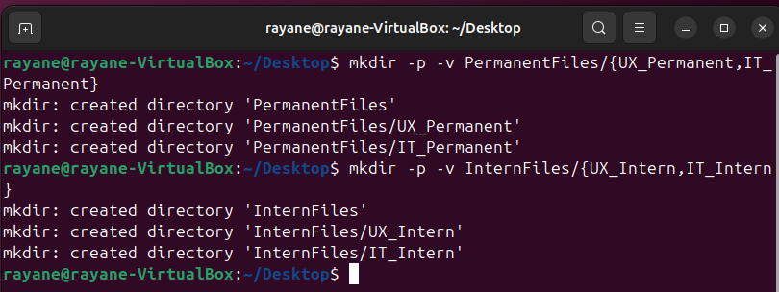
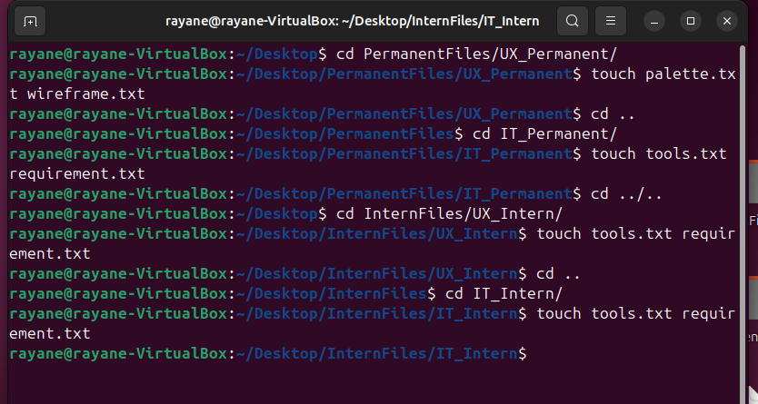
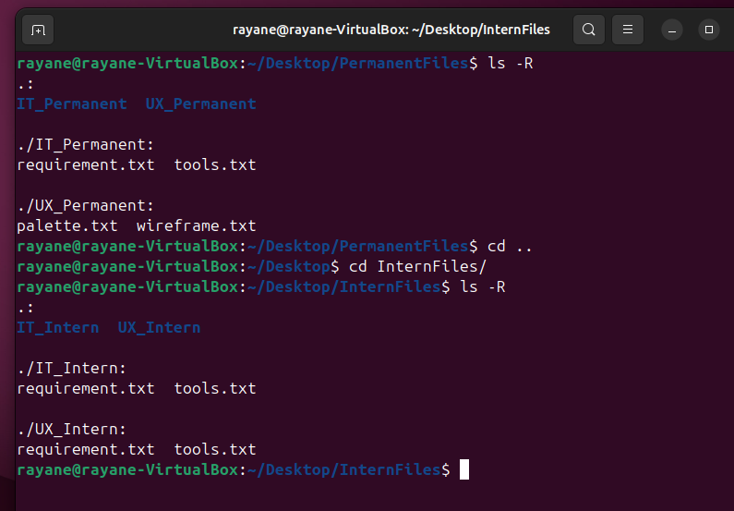
File Structure- 3
To create a folder and subfolder we use this command
  mkdir
To create files, we will use this command:
  touch

Slide 10
Group Accounts- 4
Here we will create 2 different groups, one for the permanent employees and one for the interns.

Slide 11
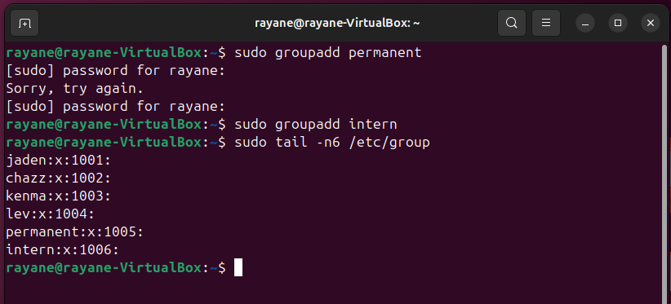
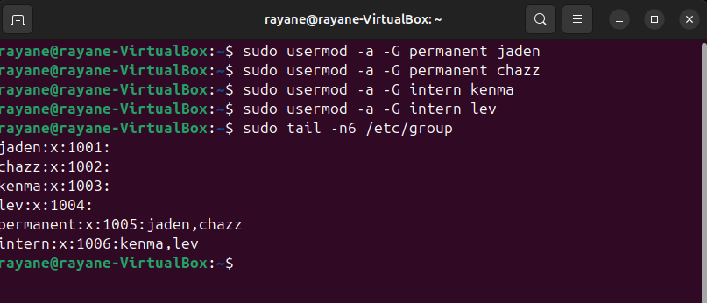
User Accounts
To create a group acc, we use the command:
  groupadd
We will create 2 groups:
  permanent
  Interns
To add the users to their respective groups, we use the command:
  usermod

Slide 12
File Permissions- 5
Here we will change ownership, change permission and copy files to /etc/skel

Slide 13
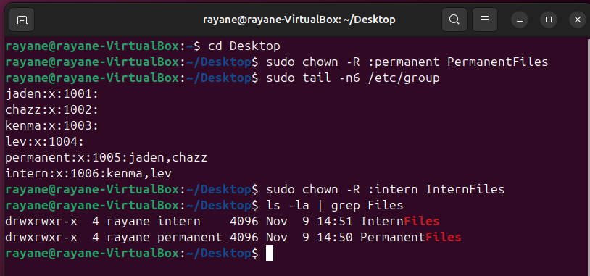
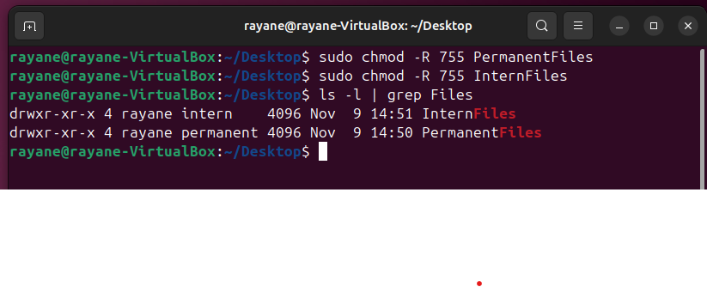
User Accounts
To change ownership, we use the command:
  chown
We will change ownership for:
  PermanentFiles
  InternFiles
To change permissions, we use the command:
  chmod
We will change permission of:
  PermanentFiles dir
  InternFiles dir
WE WILL NOT USE SPECIAL PERMISSION
Rayane has full control to both files

Slide 14
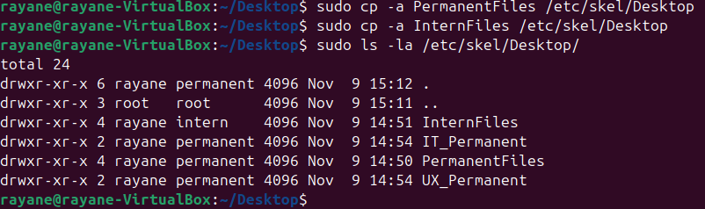
User Accounts
To copy files to /etc/skel, we use the command:
  cp

Slide 15
Backup- 6
Here we will create a backup, verify it, and schedule a regular backup (cron)

Slide 16
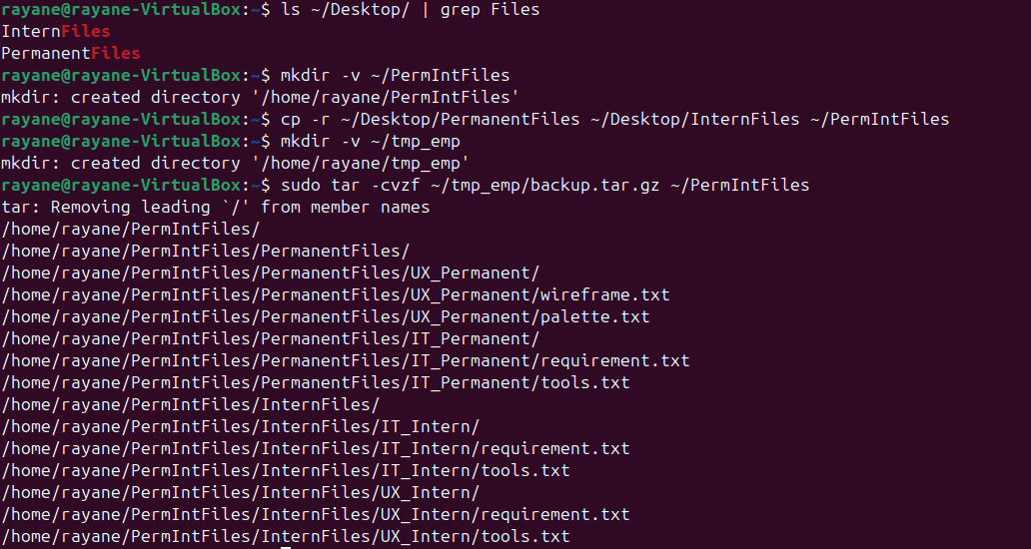
Backup
To create a backup we will first create a comnpressed archive using
  tar
  We will use the –cvzf flag (create new archibe, verbose, compress with gzip, specify archive file name)

Slide 17
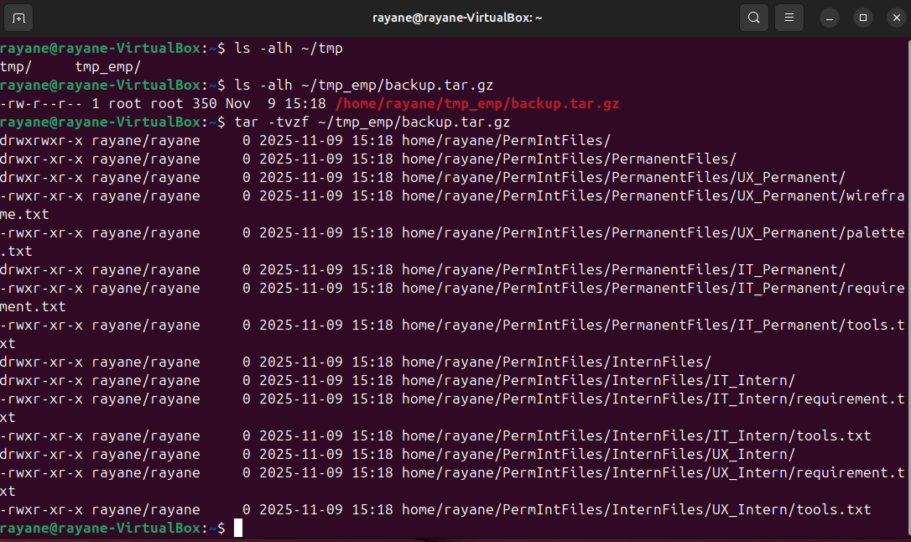
Backup
We will verify backup
Check the backup was created
And look at what is inside the backup

Slide 18
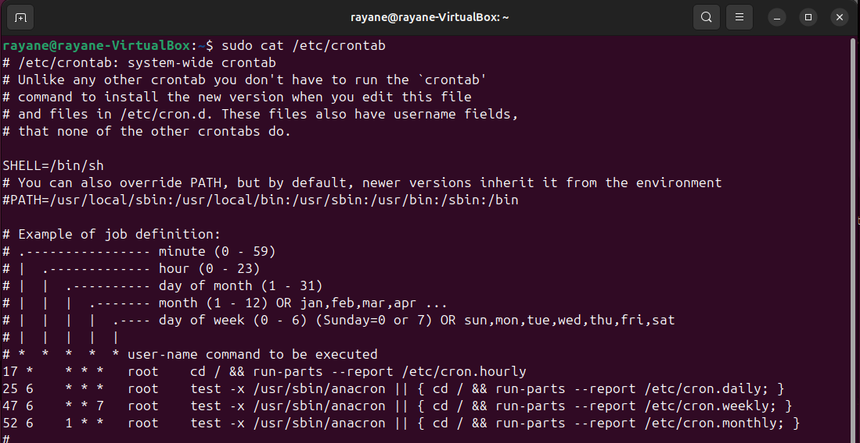
Backup
We will schedule a regular backup
  Check /etc/crontab

Slide 19
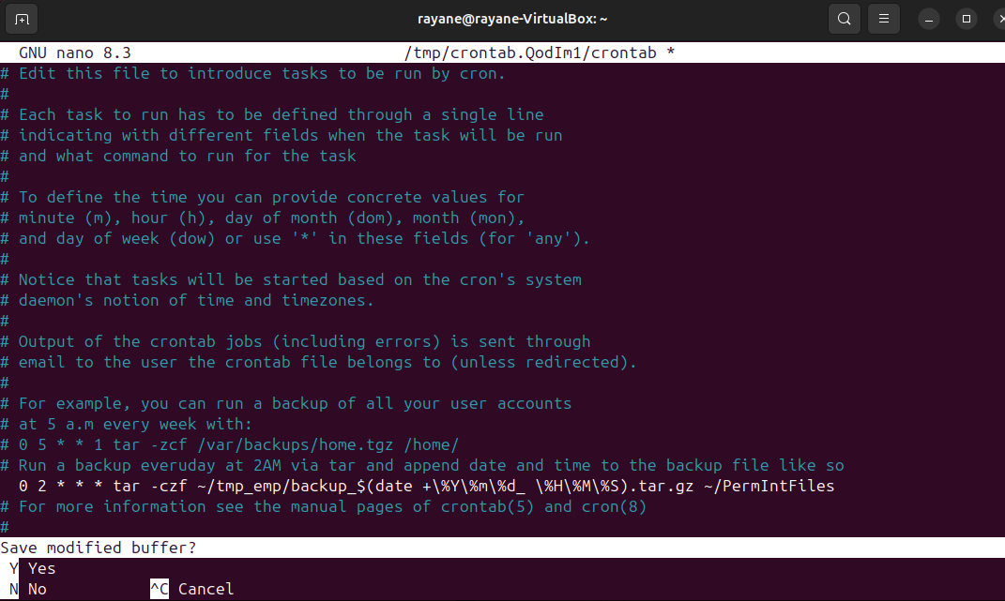
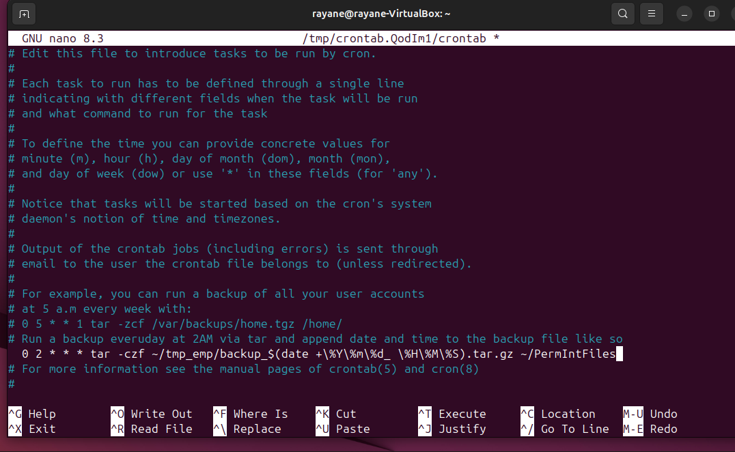
Backup
We will schedule a regular backup
  Open crontab to edit it via crontab –e we will use /bin/nano (could not take a screenshot as done before managing to take a picture)

Slide 20
Conclusion- 7
We create a new company and in that company we have added 2 permanent employees and 2 interns. We created folders and files for both groups , then we created 2 Group Accounts one for the intern one of the permanent employees and moved them to the group. We set ownership and permissions. Then we create a back and added a cron job to backup everyday at 2am

